Slide 1
English
2018-19 results:
87% achieved Grade 4+ (C or above)
68% achieved Grade 5+ (C+ or above)
25% achieved Grade 7+ (A or above)
English Literature exams:
Wednesday 13th May 2020
Thursday 21st May 2020

Slide 2
English Literature
The course
Component 1
Shakespeare
One extract question and one essay question based on the reading of a Shakespeare text.
b) Poetry 1789 – present
Two questions based on poems from the poetry anthology, one of which involves comparison.
Component 2
Post 1914 Drama
19th Century Prose
Answer a question, using the printed extract and knowledge of the whole text.
c) Unseen poetry
Two questions on unseen poems, one of which involves comparison.

Slide 3
Why bother?
* A grade 4 or higher must be achieved in Language or Literature to avoid resitting post 16*
It is just as important as English Language!
It is a rigorous qualification that is very well respected.

Slide 4
Exam Papers
Component 1 tests your reading and understanding of a Shakespeare play and a range of pre-seen poems.
One hour to answer questions linked to Macbeth or Romeo & Juliet – one short, extract based question and one longer essay about an issue across the whole text.
One hour to answer questions about poems studied, as part of an anthology – one question about a single poem and one that compares and contrasts two poems.
NO TEXTS ARE PERMITTED IN THE EXAM.

Slide 5
Exam Papers
Component 2 tests your reading and understanding of a novel, a play and two unseen poems:
45 minutes to answer a question about Blood Brothers or An Inspector Calls, using the printed extract and knowledge of the whole text.
45 minutes to answer a question about A Christmas Carol, using the printed extract and knowledge of the whole text.
One hour to answer questions about unseen poems – one question about a single poem and one that compares and contrasts two poems.
NO TEXTS ARE PERMITTED IN THE EXAM.

Slide 6
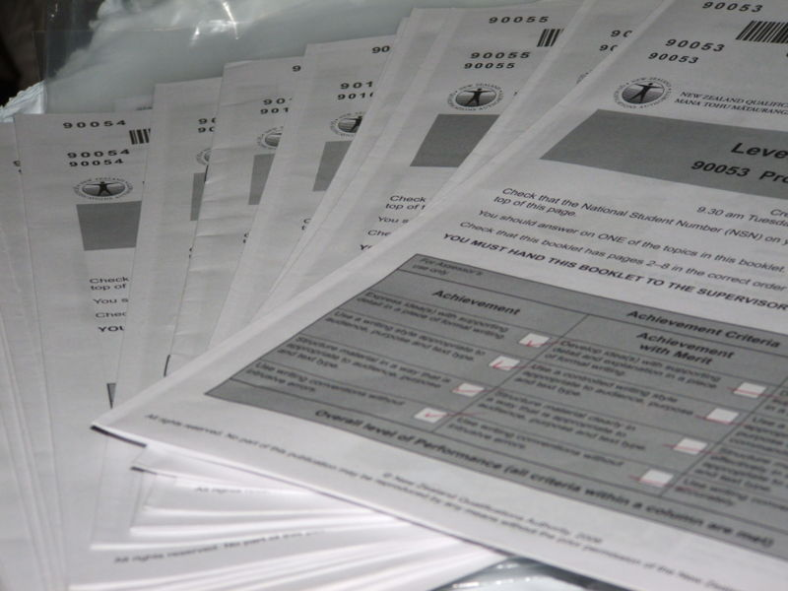
Preparation
Students must track texts carefully and explain meaning, with reference to the text – just like in the Language papers.
Look at an exam paper and see for yourself what they will be tested on…

Slide 7
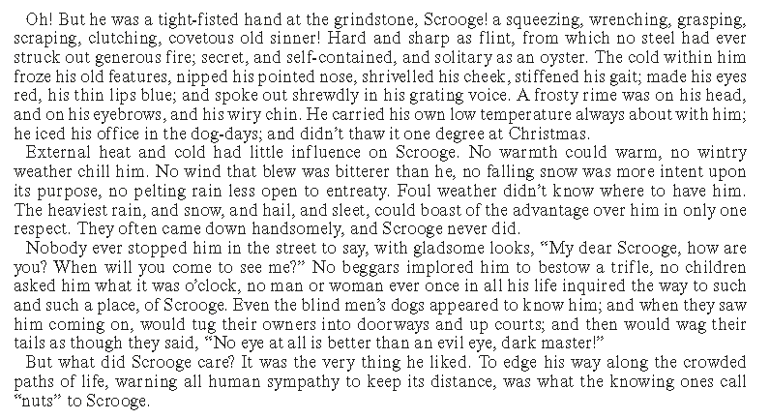
Example paper
Find phrases to help you answer the question…
Write about Scrooge and the way he changes throughout the novel.

Slide 8
Twist or stick?
Holds on to his money
Hard taskmaster
Ruthless
Write about Scrooge and the way he changes throughout the novel.

Slide 9
Twist or stick?
Selfish
Egotistical
Write about Scrooge and the way he changes throughout the novel.

Slide 10
Twist or stick?
Isolated
Independent
Write about Scrooge and the way he changes throughout the novel.

Slide 11
Twist or stick?
Something useful on every line!
Write about Scrooge and the way he changes throughout the novel.

Slide 12
Write about Scrooge and the way he changes throughout the novel.
Track the text chronologically
At the start of the novel, Dickens immediately presents Scrooge as a ruthless character as he is described as a ‘tight fisted hand at the grindstone’, suggesting to the reader he is a hard taskmaster who pushes his workers to their limit. Scrooge is then labelled ‘a covetous old sinner’, with Dickens implying through the adjective ‘covetous’ that he is a selfish and egotistical character, and by referring to him as a ‘sinner’, perhaps Dickens is showing the reader from the start that Scrooge behaves in a negative or inappropriate fashion.
Make a point
Provide evidence
Explain the idea further
Credit the writer
Be tentative
Zoom in on words

Slide 13
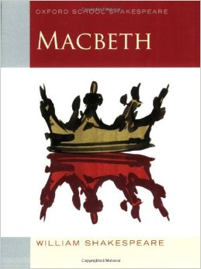
How to succeed…
Read the texts again, at home
Learn quotations about main characters and themes in each text
Use words from the question in your answer
Use quotations to help you explain your ideas
Track the text chronologically
Explain meaning behind words and phrases
Talk about the context behind the text
Talk about structure and how the text has been pieced together
Stick to the timings suggested
Keep writing until you are told to stop!

Slide 14
Time is Ticking
Begin to Prepare Now!
Revision guides are available to buy online, via ParentPay, distributed by the school shop.
English Literature revision guides (Macbeth/Romeo & Juliet, A Christmas Carol & Blood Brothers/An Inspector Calls, Anthology poetry and Unseen poetry)

