Slide 1
https://www.loom.com/share/702d2910850840fd9f38809a4908946c
Click on this link to hear Miss Chalmers explain this new project further

Slide 2
WE CHALLENGE YOU!
The challenge is split into 4 areas and will be cover over the next 4 weeks.
- Week 1 - Research
- Week 2 - Designing
Week 3 - Making
Week 4 - Evaluating
These are all areas you would be covering across all materials areas if you had been in school.

Slide 4
Week 1
Research Tasks

Slide 5
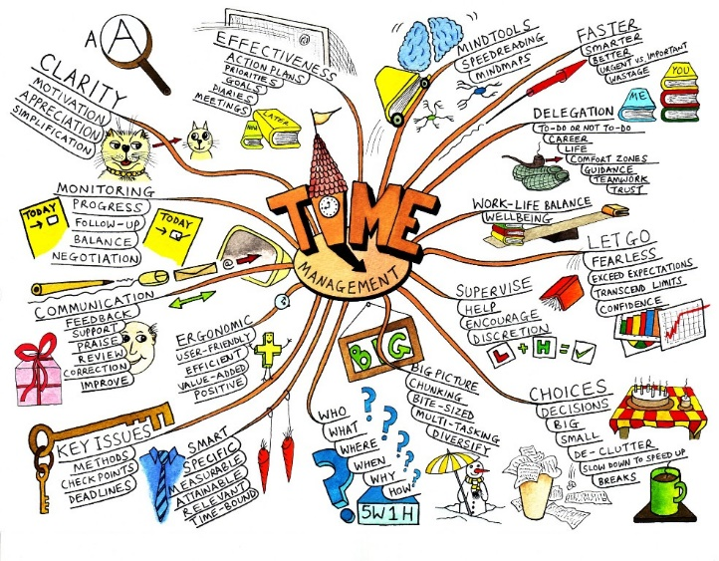
Research Tasks
Create a mind map based on the theme of monsters – think about the following areas colour, shape, user, materials, theme etc
Create a questionnaire and record your answers in a table/graph.
Write a summary of your findings. Make sure it is detailed.
Extension – find some monster products and analyse them
Remember to check your work against the research criteria

Slide 6
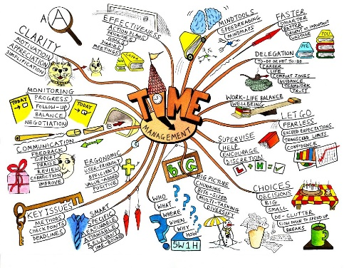
Have I?
Week 1 – Success criteria for research
4 | Gathered relevant information from a least three different sources to help you with your project including looking at existing products. You have analyzed in some depth what you found explaining how it will impact on your own design work.
3 | Gathered relevant information a least two difference sources to help you with your project and analyses what you found explaining how it will impact on your own design work.
2 | Gathered some information to help you with your project and carried out some analysis of what you gathered and explained how it will help you
1 | Gathered some information to help you with your project and carried out some superficial analysis of what you gathered.

