Slide 1
Mathematics
How to help your year 10 student with maths

Slide 2
The faculty is very experienced and one of the most successful in the county.
We have a dedicated and caring staff who really cater for student needs.

Slide 3
New exam
As you will be aware, your students are studying for a GCSE Mathematics qualification with grades from 9-1.
There are two tiers , Foundation and Higher.

Slide 4
Equipment
It would really help students to have their own equipment and calculator to use now and to practise with at home.
All students need a scientific calculator. We recommend the Casio fx-83GT PLUS
They need compasses, a ruler, a 360º protractor.

Slide 6
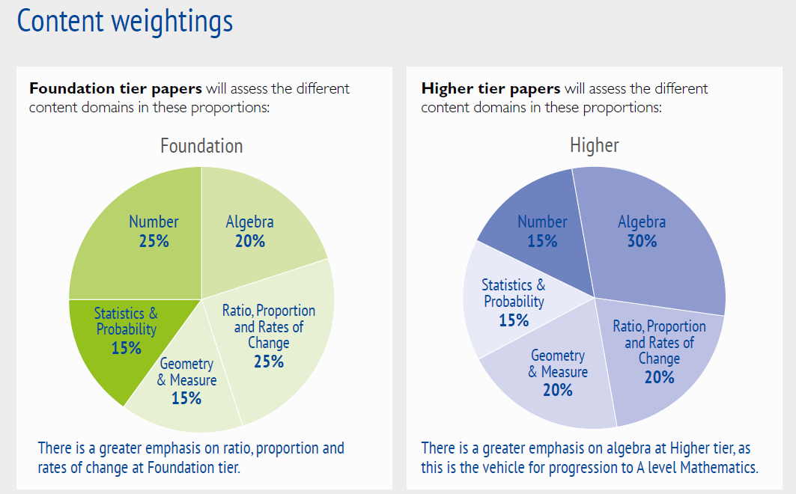

Slide 7
Types of questions on the papers
There is now a bigger emphasis on problem solving.
The breakdown of papers is:
Using and applying standard techniques, straight forward using maths. (50% of Foundation papers, 40% of Higher)
Reasoning, interpreting and communicating mathematically (25% of Foundation and 30% of Higher)
Solving problems, can be mathematical and non-mathematical contexts (25% of Foundation and 30% of Higher)

Slide 8
7 will be anchored to grade A - ‘Broadly the same proportion of students will achieve grade 7 and above that currently achieve an A and above.’ (15% get A and above now, around 25% in this school)
9 for the top 3% or so - ‘For each examination, the top 20% of those who get grade 7 or above will get a grade 9 – the very highest performers.’
1 is the lowest, anchored to grade G
4 will be anchored to grade C - ‘Broadly the same proportion of students will achieve a grade 4 and above as currently achieve grade C and above.’ (65% get C and above now, 75% in this school)
5 will be set between C and B – ‘Grade 5 will be positioned in the top third of marks for a current grade C and bottom third of the marks for a grade B.’ A grade 5 (available on Foundation) will become highly desirable.
2017 grades were statistically decided, linked to 2016.
The first 4/5 questions on Higher overlap with Foundation

Slide 9
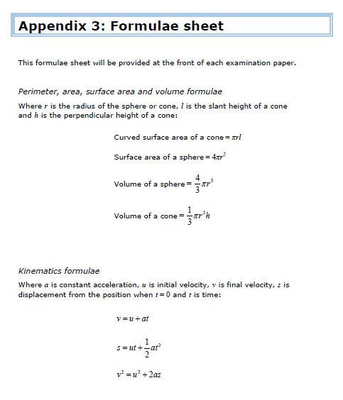
Formulae to remember:
Foundation:
Area of trapezium
Volume of prism
Higher:
Above plus
Quadratic formula
Sine and cosine rules
Area of triangle – ½ absinC

Slide 10
Newer content:
New to Foundation:
Use of pi and surds standard form
Reverse percentages compound interest
Factorising quadratics simultaneous equations
Basic trigonometry direct and inverse proportion
Circle properties fractional scale enlargements
Vectors conditional probabilities
Tree diagrams frequency trees (prob trees but frequencies not probs)
Venn diagrams
New to Higher:
Gradient at a point on a curve as a rate of change
Areas under graphs
Venn diagrams
Geometric progressions

Slide 11
Non-calc Foundation – as before – routine procedures

Slide 12
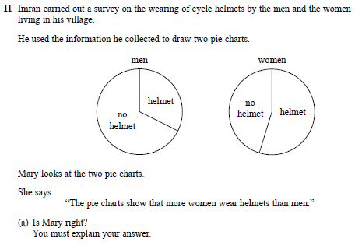
More to read. Need to practise writing reasons. Short sentences are fine. Not just one right answer as long as explained. Found half way through Foundation paper. No marks for spelling.

Slide 13
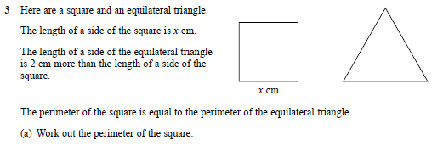
3 marks
4 marks
Foundation paper 3, calculator. Connections between different parts of maths.

Slide 14
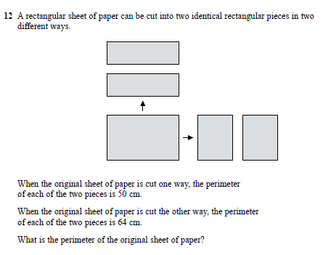
AO3 Higher question. Even though simultaneous equations are now Foundation they would get straight forward question.
5 marks
3 marks Foundation paper 1

Slide 15
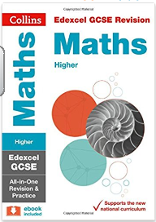
To order: £5.00 school price, RRP is £10.99

Slide 16
Mymaths
www.mymaths.co.uk
Login wollaston
Password number

Slide 17
MathsWatch
www.mathswatchvle.com
Wollaston
(student’s own login)@wollaston
WSmwma

Slide 18
Past Examination Questions
www.gcsetakeaway

Slide 19
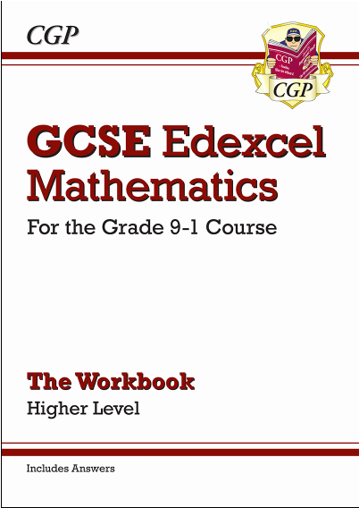
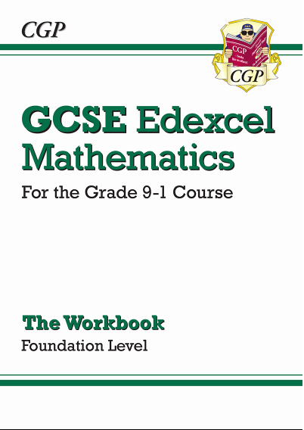
Practice books

Slide 20
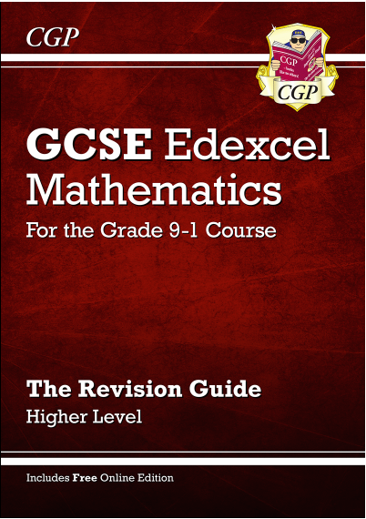
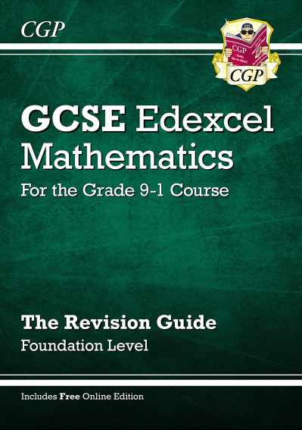
Revision guides and practice books

