Slide 1
Science Year 11
Exam Preparation

Slide 2
Overview
The Course
Assessment
Examinations
Question Styles
Preparation
Facts
Application of Facts

Slide 3
The Course
AQA Combined Science: Trilogy (8464)
When searching for revision
“AQA GCSE Combined Science: Trilogy”
Teaching from September 2016

Slide 4
The Combined Science Exams
This course is 100% examined
There are 6 exams, each covering a different area.
All are 1hr 15 mins long
Two Biology
Two Chemistry
Two Physics
Multiple choice, structured, closed short answer, and open response.
Combined Science Counts to two GCSE
Twice the work
Twice the reward

Slide 5
The Trilogy Exams
Paper | Topic Number | Titles
Biology 1 | Biology topics 1–4: | Cell Biology; Organisation; Infection and response; and Bioenergetics.
Biology 2 | Biology topics 5–7: | Homeostasis and response; Inheritance, variation and evolution; and Ecology.
Chemistry 1 | Chemistry topics 8–12: | Atomic structure and the periodic table; Bonding, structure, and the properties of matter; Quantitative chemistry; Chemical changes; and Energy changes.
Chemistry 2 | Chemistry topics 13–17: | The rate and extent of chemical change; Organic chemistry; Chemical analysis; Chemistry of the atmosphere; and Using resources.
Physics 1 | Physics topics 18–21: | Energy; Electricity; Particle model of matter; and Atomic structure.
Physics 2 | Physics topics 22–24: | Forces; Waves; and Magnetism and electromagnetism

Slide 6
Combined Exam Dates
Biology 1 | 19th May 2021
Chemistry 1 | 24th May 2021
Physics 1 | 27th May 2021
Biology 2 | 14th June 2021
Chemistry 2 | 17th June 2021
Physics 2 | 22nd June 2021

Slide 7
Tier of Entry
There are Tiers for Science
This will be decided in spring
Foundation is grades 1-5
Low (1-3) and standard (4-5) demand questions
Higher is grades 4-9
Standard (4-5), standard/high (6-7) and high demand questions (8-9).

Slide 8
Mathematical Requirements
Students will need to use their GCSE maths knowledge in science.
10% Biology
20% Chemistry
30% Physics

Slide 9
Assessments
40% will assess knowledge and understanding of scientific ideas, techniques and procedures.
40% will assess your application of those ideas
20% will assess candidates ability to;-
interpret
evaluate
make judgements
draw conclusions
develop experimental procedures
improve experimental procedures

Slide 10
The Exam Questions
Multiple Choice Questions
Long Answers
Increased mathematical requirements
Familiarity with command words
Increased demand

Slide 11
Revision Guides
It used to be that “If you know your revision guide you will get a 4 or 5.”
This is no longer the case.
To get a 4 and above you need to be able to apply and discuss the Science.
Revision guides are the first step.

Slide 12
Exam Preparation
Revision Guides
Workbooks
Learning Checklists
Mindmaps/flash cards and other techniques (search YouTube – how to revise for GCSE exams)
Past Papers
Sample papers and specimen papers (Search “AQA GCSE Combined Science: Trilogy”)

Slide 13
Online help…
Search “how to revise for GCSE exams?” in YouTube and see what advice there is (pick 2 or 3 good strategies)
YouTube Channel – myGCSEscience
YouTube Channel – Primrose Kitten (search “Primrose Kitten AQA chemistry for the new spec 9-1)
GCSE Bitesize (search GCSE Bitesize Combined Science) – notes, questions etc
Getrevising.co.uk – ready made flash cards and more

Slide 14
“I can’t help, I don’t know any Science”
Encourage them to start now (maybe develop a weekly routine)
Encourage students to discuss the science on particular pages of the revision guide. Which is the most important part? Why? What are the 5 most important ideas? How does it link to the wider world?
Talk through answers to exam questions. E.g. Read the question together then the student answers while you read the mark scheme and check off correct parts and highlight anything that was missing.

Slide 15
“I can’t help, I don’t know any Science”
See if they can talk you through experimental methods. Sub sections of the revision guide are labelled “practical” This means the students must know the experimental method. You could ask what the equipment does? What the point is?
Use the questions at the bottom of each revision guide page to test students.
Challenge students to give you a lesson on a certain topic or subtopic.

Slide 16
Any Questions?

Slide 17
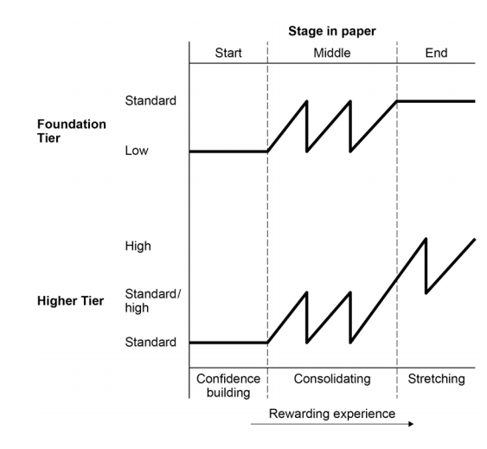
Demand of Questions

Slide 18
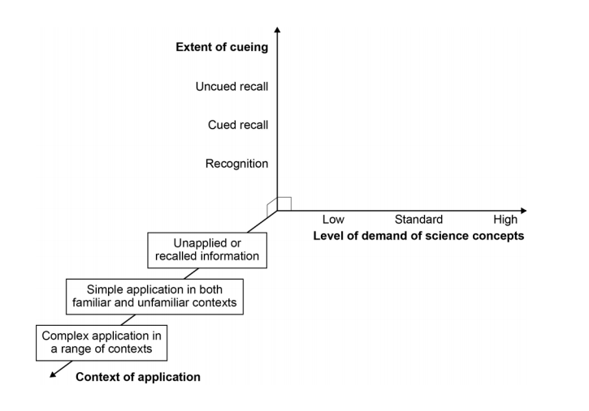
How will they be demanding?

Slide 19
How will they be demanding?
Practice long answer questions
Model answers
Cross-referencing ideas
e.g. using rate of reaction ideas
In photosynthesis.
‘Harder Science’. More demanding theory

Slide 20
Question Design
Command words (see pack)
Use standard wording (recognised phrases)
Scaffolding is used (structuring questions)
Key information in bold
Be ready for unfamiliar ideas (they will be explained)

Slide 21
Question Approach
Command words (highlight them!)
Use standard wording (recognised phrases)
Scaffolding is used (structuring questions)
Key information in bold
Be ready for unfamiliar ideas (they will be explained). RTQ2

Slide 22
Example
Revision Guides (students already have these)
Workbooks (will be available from school)
Exam papers and mark schemes
Exam Question samples (search “AQA GCSE Combined Science: Trilogy”)

