Slide 1
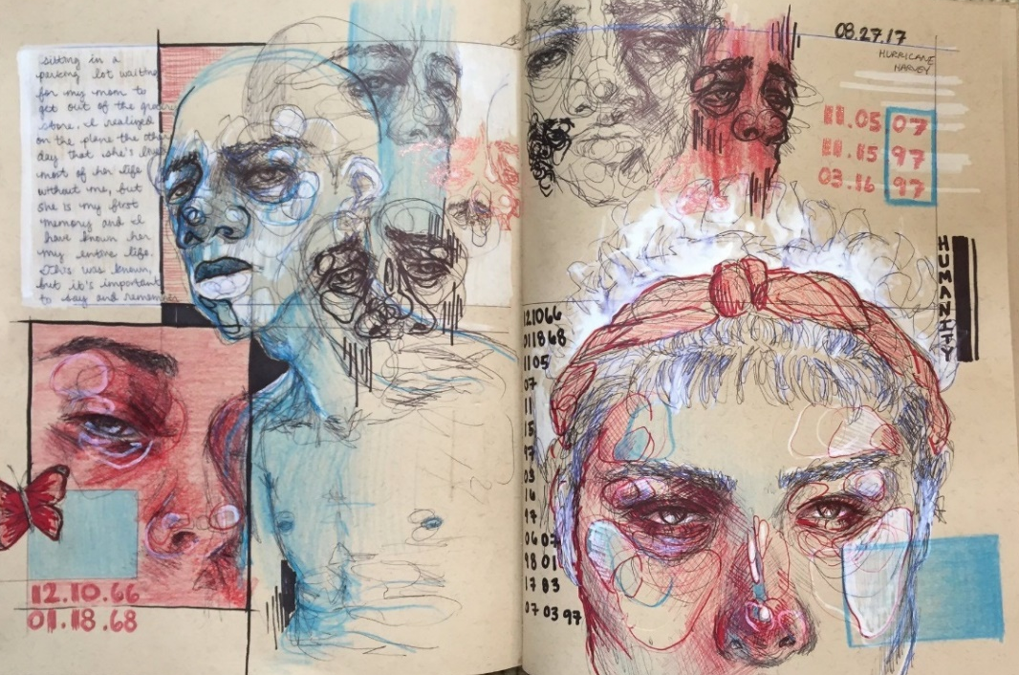
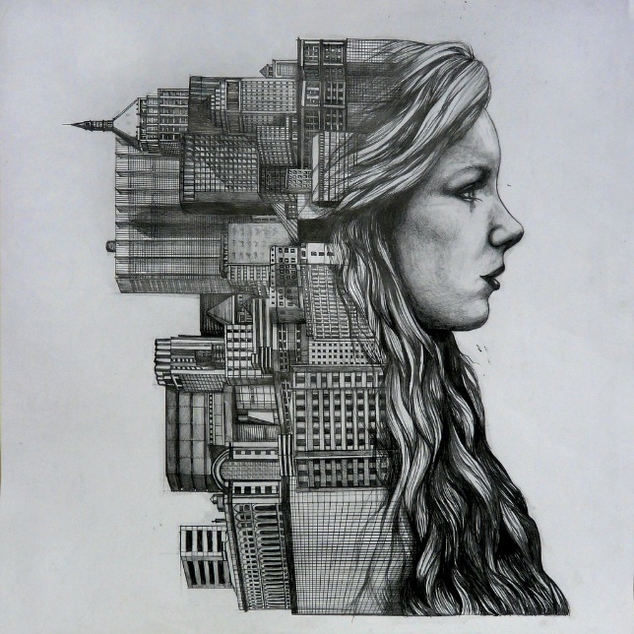
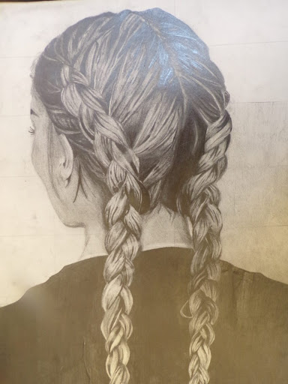
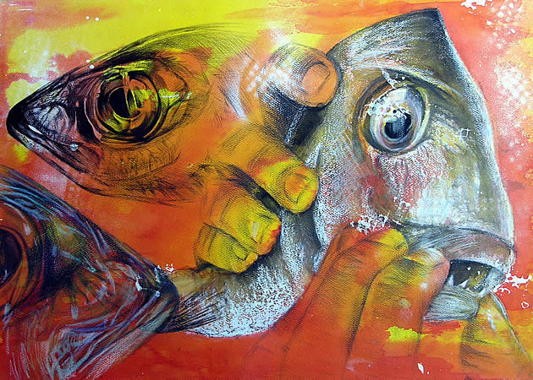
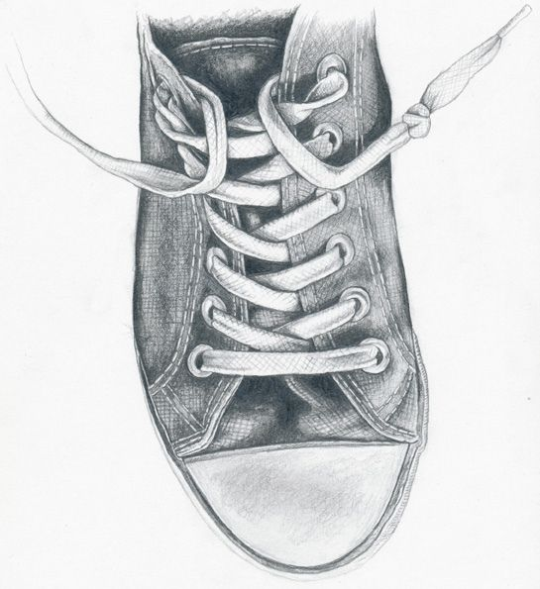
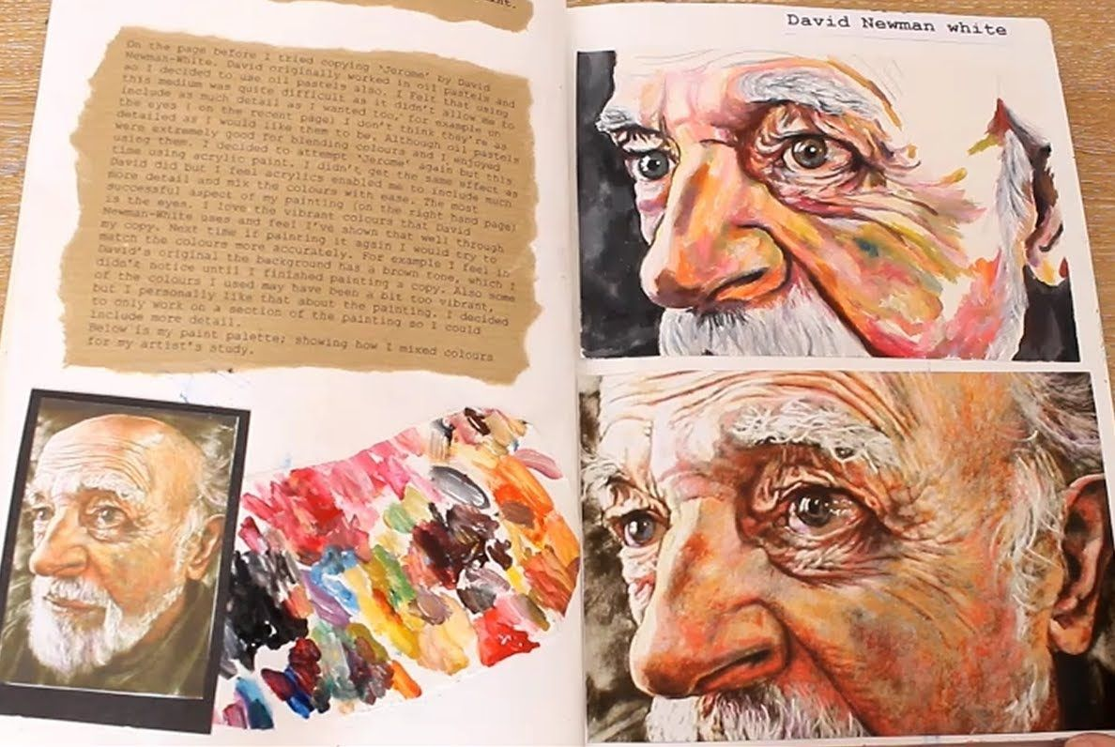
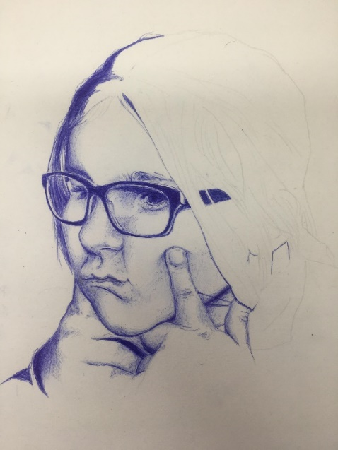
Subject: ART

Slide 2
What does an ideal Art student look like?
You will be a curious and creative person with an ability to explore and create, through the stimulus that you are given and the world around you! You will have a passion for drawing and will have confidence when it comes to applying formal skills. You take note of the world around you and are critical and self reflective. You are able to effectively apply skills learnt at KS3. You are open to feedback, proactive and are keen to explore and experiment with a wide range of techniques and processes.
What does the course entail?
You will work from 2 themes one in year 10 and the other in year 11, these themes will then tie together to develop a considered and extensive final out come. In the January of year 11 you will be given an externally assessed theme.
Although art is mainly a practical subject, you will be expected to record your opinions and explain your decisions of how you made your work through written feedback. The course although diverse in content and ways of working; does however, require a high level of drawing.
How will students be assessed?
Unit 1 ‐ 2 pieces of coursework produced across Yr10 and Yr11. Classwork and homework included. This is 60% of the final grade.
Unit 2 ‐ Externally Set Assignment. This 40% of the final grade. Includes prep for the exam in the form of a sketchbook with a final piece being completed in exam conditions across a 10 hour time period
Where can this lead to?
The obvious routes are A levels and BTECs and then a career in Fine Art or art related careers. Such as architecture, fashion, film, media... Many universities and job providers look for Art as a qualification, as they welcome students with creativity and innovation. Law degrees require critical thinkers, a skill that sometimes get over looked!

