Slide 1
WOLLASTON
SCHOOL
Uniform and Equipment 2021—2022
INSPIRE MOTIVATE ACHIEVE
Wollaston School, Irchester Road, Wollaston, Northants, NN29 7PH
TEL: 01933 663501 FAX: 01933 665272 E-MAIL: headteacher@wollaston-school.net WEB: www.wollastonschool.com

Slide 2
Uniform Policy
At Wollaston we believe that a school uniform gives a sense of belonging and pride in the school whilst ensuring equality amongst students.
We believe a smart appearance impacts positively on:
the students’ attitude to work and study;
how the school is portrayed to the general public and visitors to the school.
This booklet sets out our uniform expectations giving you, the parent/carer, the information you need to ensure the correct items are being purchased to avoid unnecessary additional expense.
In order to ensure your son/daughter meets our uniform expectations, please take the time to look at the images included. Whilst this is not an exhaustive list it does provide clear guidance on what is and is not acceptable.
School uniform items can be ordered online via our school website www.wollastonschool.com and will be available for collection in school, usually within 24 hours of payment. Our refund and exchange policy can be found on our website.

Slide 3
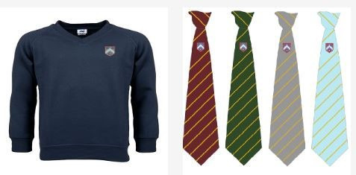
Compulsory Items
The following items are compulsory and must be worn at all times*:
Plain black or dark grey tailored trousers or skirt (of appropriate length and fit)
Plain white shirt
House tie
School sweatshirt
Formal leather black shoes
*During warmer weather the school reserves the right to make changes to ensure students are comfortable. This may include allowing students to remove sweatshirts and the school tie.

Slide 4
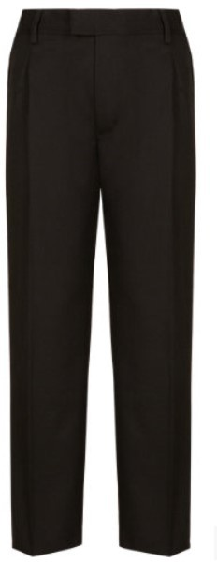
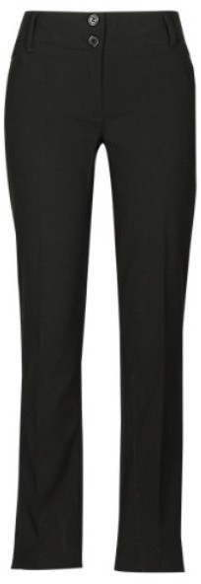
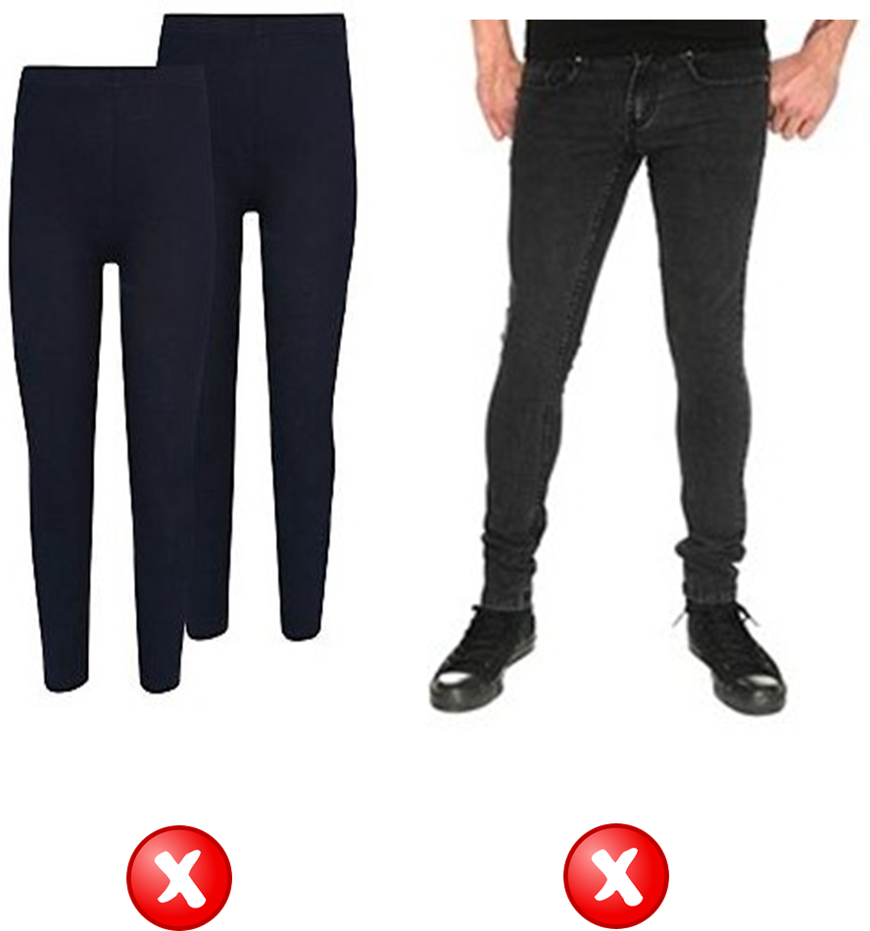
Trousers
Plain black or dark grey tailored trousers of appropriate length and fit.
The following examples are NOT appropriate uniform items:
Black jeans style trousers and leggings/jeggings are not acceptable.
Please note that some high street clothing stores put black jeans into their ‘school sections’ but do not meet our requirements so shoudll not be purchased for school.

Slide 5
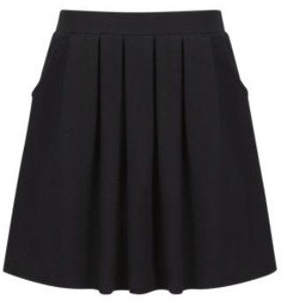
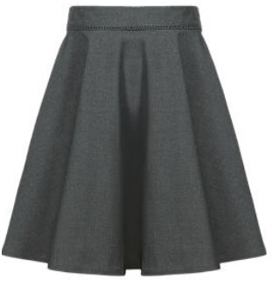
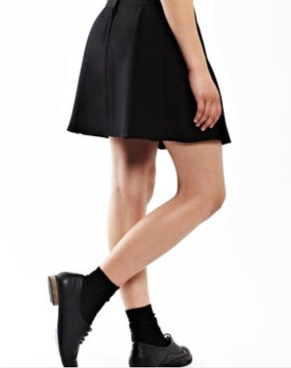
Skirts
Acceptable items— Plain black or dark grey skirt of appropriate length and fit
The following examples are NOT appropriate uniform
items:

Slide 6
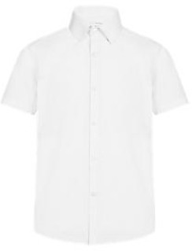
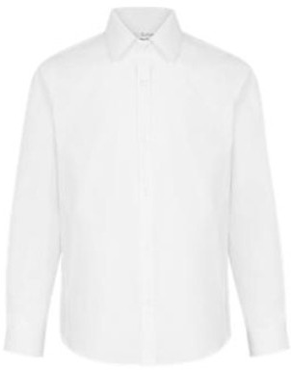
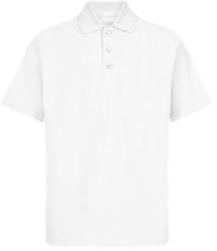
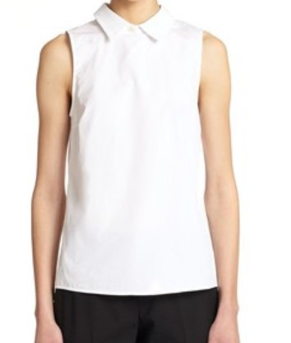
Shirts
Plain white shirt
To be worn tucked in and with the top button done up.
The following examples are NOT appropriate uniform items:
Polo Shirt
Sleeveless Shirt

Slide 7
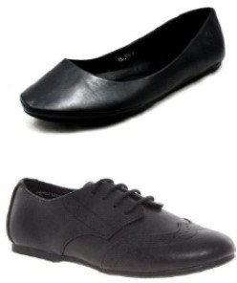
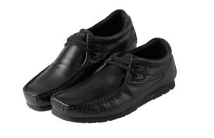
Footwear
All shoes (boys and girls) must be formal, leather and completely black.
We are aware that some shops sell products advertised as ‘school shoes’ which are not compliant with our uniform policy. If in any doubt please do not hesitate to contact your year team.
Open toed shoes are not acceptable due to potential dangers in Technology or Science.

Slide 8
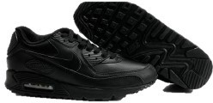
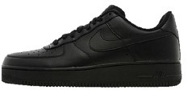
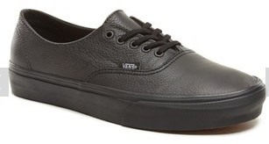
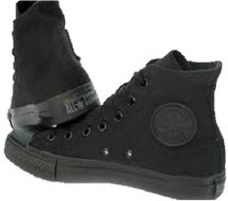
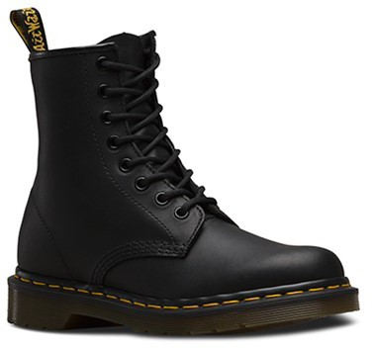
Footwear
The following examples are NOT appropriate uniform items: All types of trainer/canvas shoes are not permitted
Black leather/canvas Vans
Converse style
Students who study Vehicle Engineering are permitted to wear ’work’ boots for practical lessons only.

Slide 9
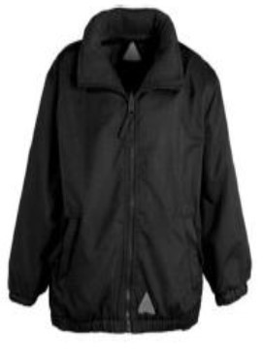
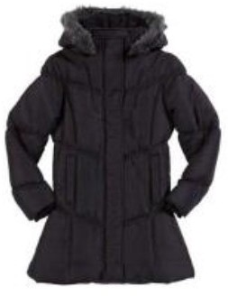
Coats
May be worn outside of lessons.
Hoodies, sports tops, tracksuit tops and other branded
sweatshirts are not acceptable and should not be a substitute for an outdoor coat.

Slide 10
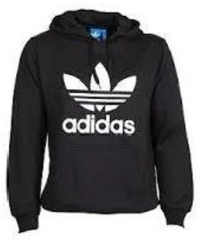
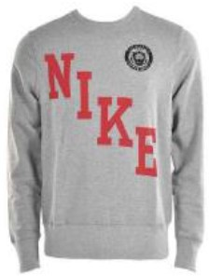
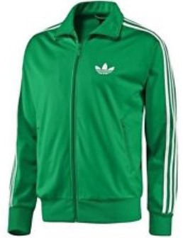
Coats
The following are not appropriate uniform items:
Hoodies Branded sweatshirts
Sport zip tops

Slide 11
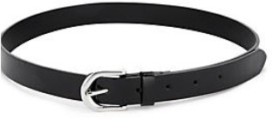
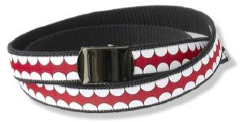
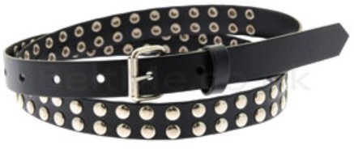
Belts
Belts (if worn) should be plain, black with no studs or patterns.
The following are NOT appropriate uniform items:

Slide 12
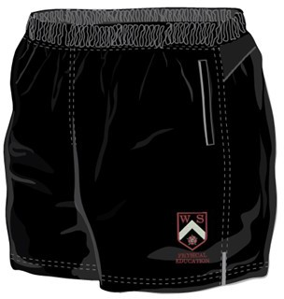
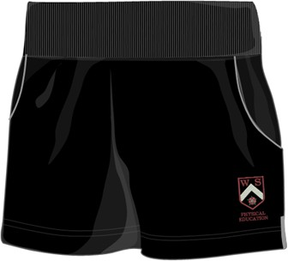
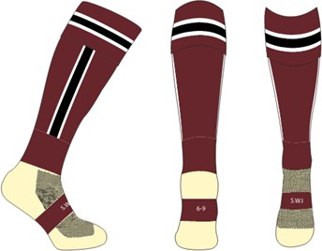
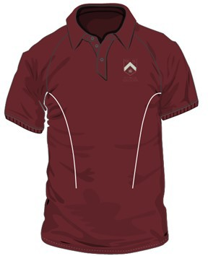
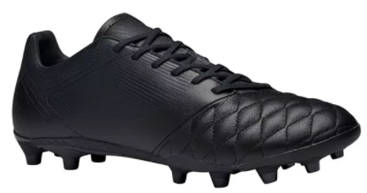
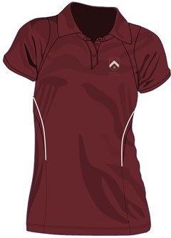
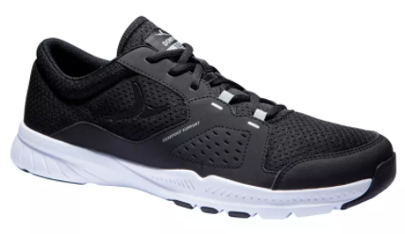
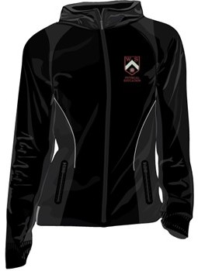
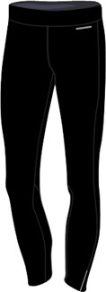
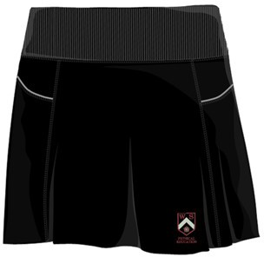
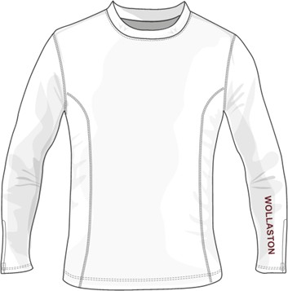
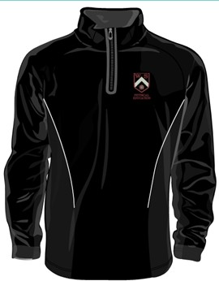
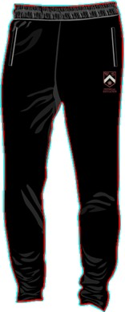
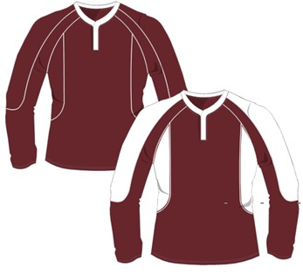
PE UNIFORM
Compulsory items
Male
Female
Male and Female
or skort alternative below
Optional Items - female
Optional Items - male

Slide 13
Appearance
In addition to appropriate clothing, all students are expected to maintain a neat and tidy appearance.
Students should meet the following expectations at all times.
Jewellery
No bracelets, bangles, wristbands of any kind. No rings or necklaces.
Earrings (only one pair) if worn should be gold or silver studs.
Nose studs, tongue and any other visible piercings are not permitted. The school will not be held responsible for expensive items of jewellery lost on the
premises.
Make up
Must be minimal and neutral in colour.
Nails
Nails should be kept at a suitable length. False nails are not permitted. Clear nail varnish only. Students arriving with coloured nail varnish will be supplied with nail varnish remover and asked to remove it.
Hair
Natural hair colours if dyed.
Hats/Scarves/Gloves
To be worn outside of school buildings only, not allowed in lessons. Suitable for winter weather and not as a fashion accessory.
Bags
An appropriate school bag e.g. rucksack or holdall to transport books and equipment including pens and pencils.

Slide 14
Equipment
All students are required to be appropriately equipped for their learning and, as a minimum, must have the following stationary equipment every day.
2 x black/blue writing pens (ballpoint or rollerball)
1 x green writing pen
2 pencils (HB)
Ruler
Eraser
Highlighter pen (any colour)
Glue stick
Colouring pencils
Scientific calculator
Protractor
Compass

